Slide 1
Introduction to Computer Programming Lecture 1.1:
Course Introduction
Hemma Philamore
Department of Engineering Mathematics

Slide 2


We are …
Hemma Philamore
Unit Director
hemma.philamore@bristol.ac.uk
Mark Blyth
Head TA
m.blyth@bristol.ac.uk

Slide 3
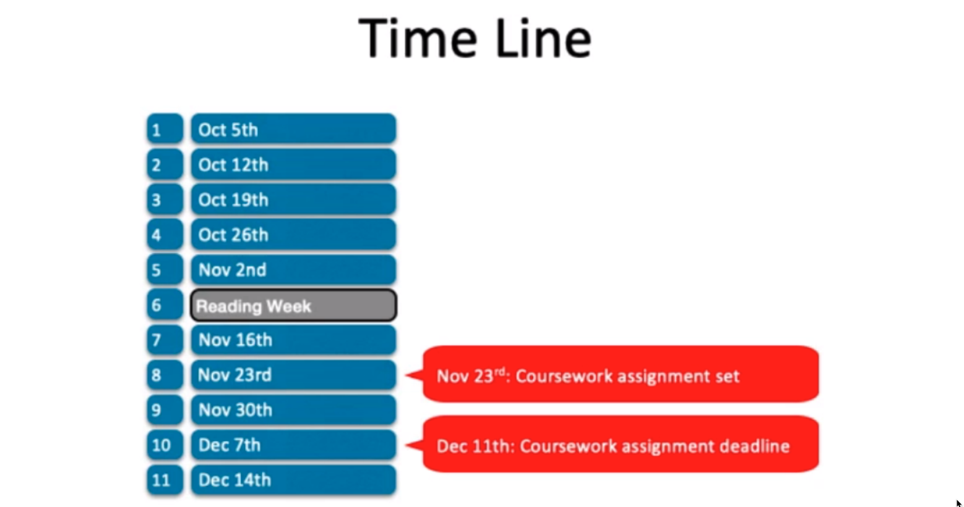
Time Line
1
Oct 5th
2
Oct 12th
3
Oct 19th
4
Oct 26th
5
Nov 2nd
6
Reading Week
7
Nov 16th
8
Nov 23rd
Nov 23rd: Coursework assignment set
9
Nov 30th
10
Dec 7th
Dec 11th: Coursework assignment deadline
11
Dec 14th

Slide 4
Weekly Schedule
Monday:
Watch recorded video tutorials (2-3 videos per week), Blackboard or YouTube: https://www.youtube.com/playlist?list=PLIePLwgNVGWElRQviZ2izI8UR8dYPWrTI
Complete exercises by Friday of the same week
Wednesday (14:00-16:00):
Optional drop-in class
Support and help with completing exercises 1-to-1 support from teaching assistants via video chat
Friday (see timetable for your group meeting time):
Group tutorial with teaching assistant

Slide 5
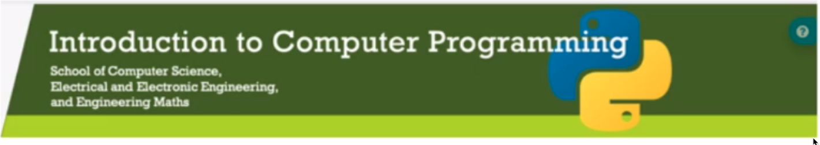
Blackboard site: http://www.ole.bris.ac.uk
Course documents
Tutorial videos and slides
Examples
Weekly exercises
Schedule
Contact details

Slide 6
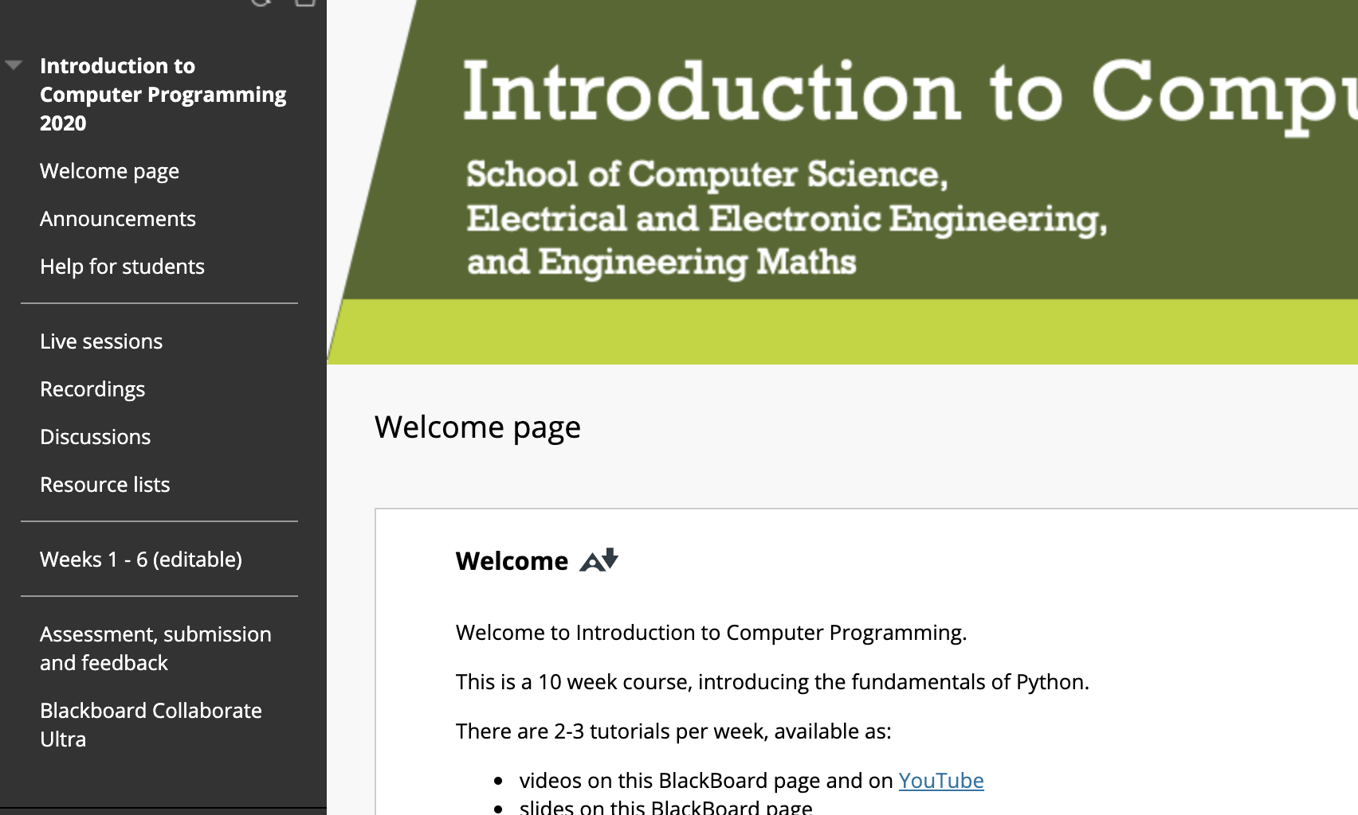
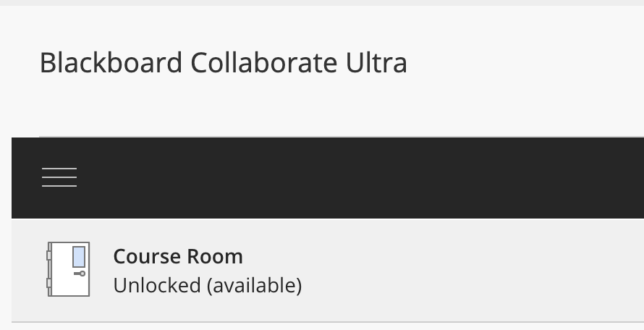
Drop-in Classes Wednesday
1-to-1 support to help with weekly exercises
Click to enter the Course Room
You will be assigned a TA for 1-to-1 support
Choose Blackboard Collaborate Ultra from the side pane of the main Blackboard page

Slide 7
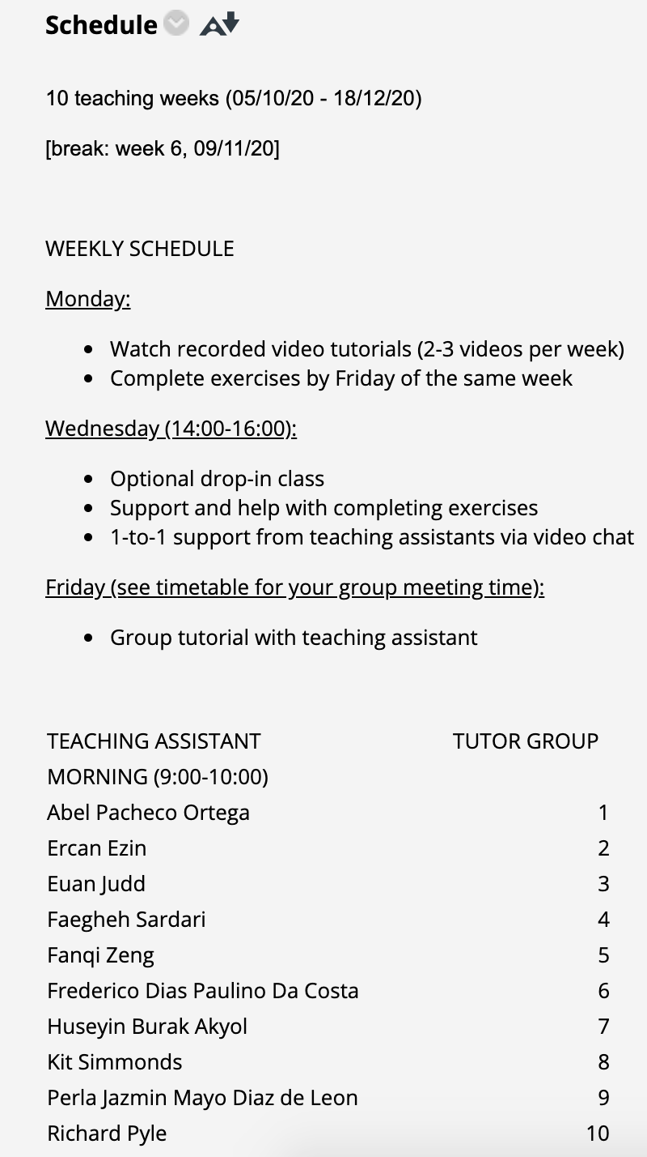
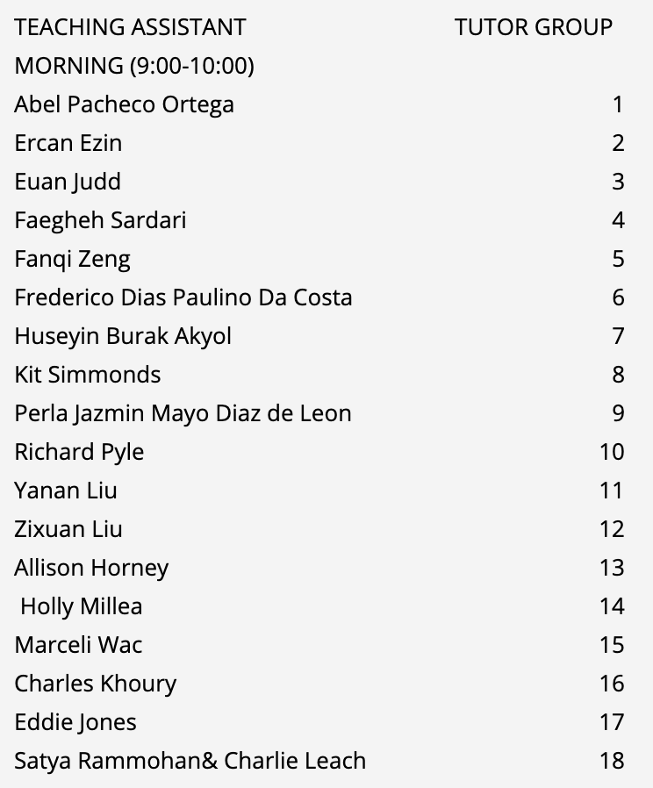
Tutorials Friday
Morning 9:00-10:00
Afternoon 13:00-14:00
Your teaching assistant will email you to arrange your first tutorial.
Blackboard Collaborate Ultra

Slide 8
What do you need to know?
No programming skills necessary!
For those who know how to program, we’ll make sure to keep it interesting with extra challenges
Best way to learn programming is by doing it
We are here to help you!
Weekly exercises are crucial!
TAs are here to support you!
Ask questions! Try things out!

Slide 9


Use of personal laptops
Remote learning – use of personal laptops for duration of course
First task! → software installation (Anaconda, Spyder)
Watch the tutorial videos (Blackboard or YouTube)
We will help you as much as possible but you will all be using different computers and may experience different problems.

Slide 10
What is programming?
Programming is telling a computer exactly what to do.
You have to use a specific language.
You tell the computer what to do in small steps → algorithm
Computers are dumb!

Slide 11

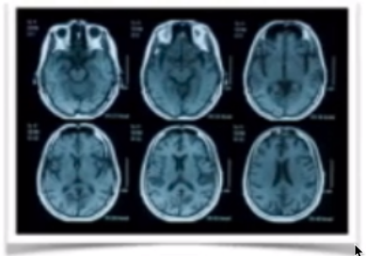

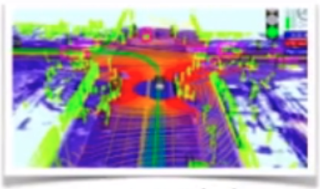
Why are we doing this course?
data science
artificial intelligence
social media
autonomous vehicles

Slide 12
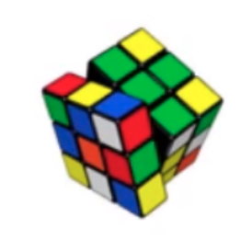
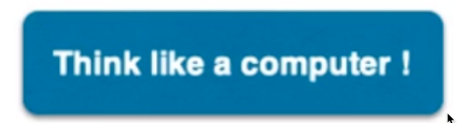
What is an algorithm?
Algorithm: self-contained step-by-step set of operations to be performed
Examples:
Cooking recipe
How to solve Rubik’s cube
Solve a quadratic equation
Find the highest value in the list
etc.
Think like a computer !

Slide 13
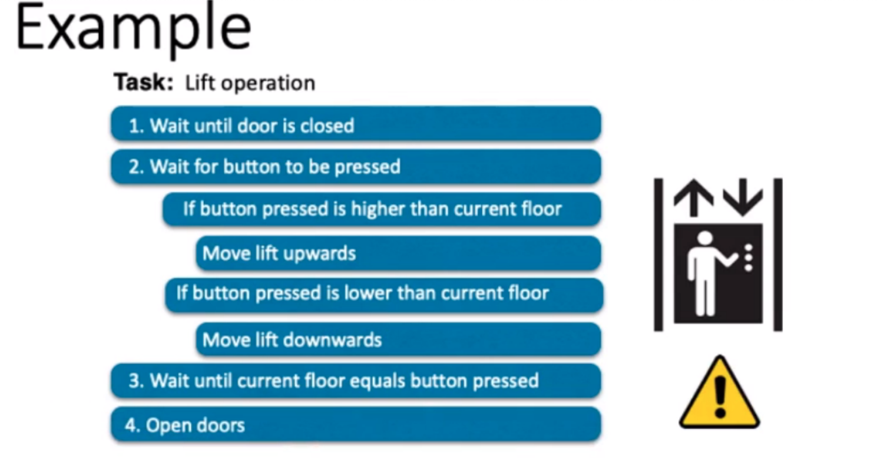
Example
Task: Lift operation
1. Wait until door is closed
2. Wait for button to be pressed
If button pressed is higher than current floor
Move lift upwards
If button pressed is lower than current floor
Move lift downwards
3. Wait until current floor equals button pressed
4. Open doors

Slide 14
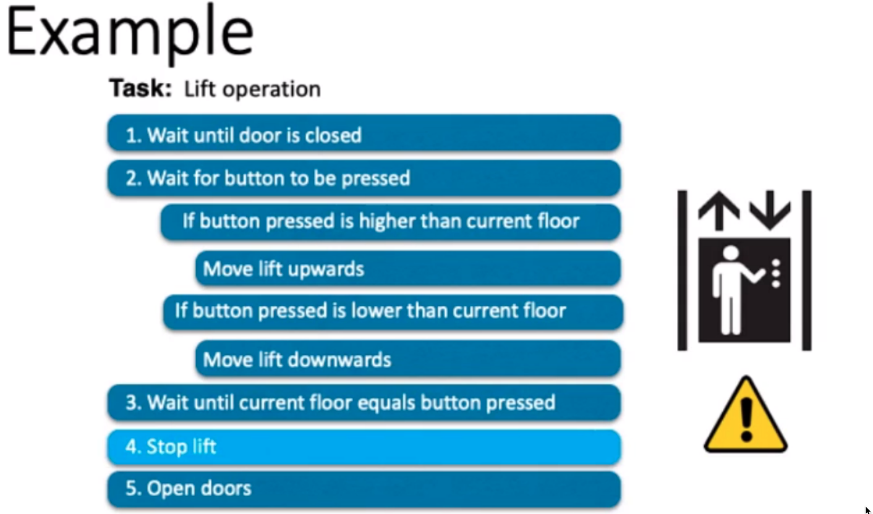
Example
Task: Lift operation
1. Wait until door is closed
2. Wait for button to be pressed
If button pressed is higher than current floor
Move lift upwards
If button pressed is lower than current floor
Move lift downwards
3. Wait until current floor equals button pressed
4. Stop lift
5. Open doors

Slide 15
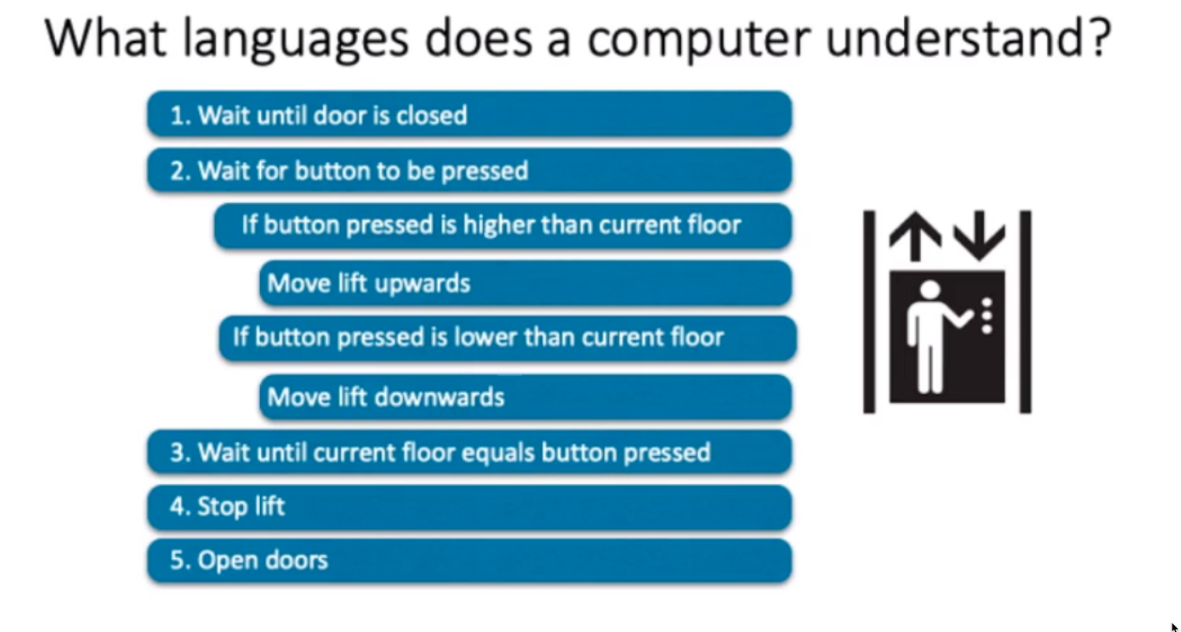
What languages does a computer understand?
1. Wait until door is closed
2. Wait for button to be pressed
If button pressed is higher than current floor
Move lift upwards
If button pressed is lower than current floor
Move lift downwards
3. Wait until current floor equals button pressed
4. Stop lift
5. Open doors

Slide 16

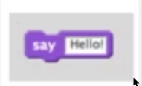
What languages does a computer understand?
our unit
machine
code
binary
code
Scratch
Python
C / Java
push es
push ds
xor ax, ax
mov es, ax
mov ds, ax
…
Hello!
print(“Hello!”)
printf(“Hello!”);
println(“Hello!”);
10010011
10100111
00011010
…
High-level
programming language
low-level
programming language
Simplicity
Power, Speed

Slide 17
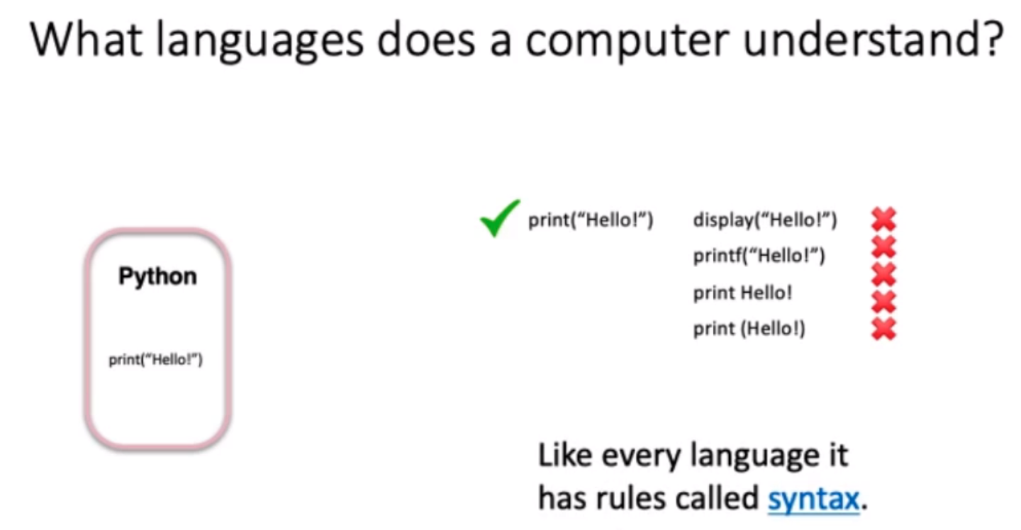
What languages does a computer understand?
our unit
print(“Hello!”)
display(“Hello!”)
printf(“Hello!”)
Python
print Hello!
print (Hello!)
print(“Hello!”)
Like every language it
has rules called syntax.

Slide 18
Next steps
Watch this week’s tutorial videos
Software installation (Mac, Windows, Linux)
Spyder software
Attempt this week’s exercises
Go to drop-in session if you have any problems (Wednesday)
Attend group tutorial (Friday)

